Slide 1


FAsT-Match: Fast Affine Template Matching
Simon Korman (TAU)
Gilad Tsur (WIS)
Daniel Reichman (WIS)
Shai Avidan (TAU)
*to appear at CVPR 2013

Slide 2
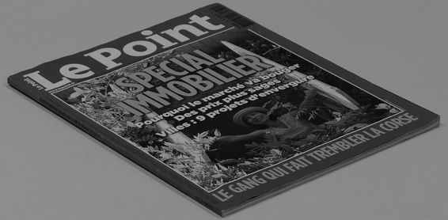
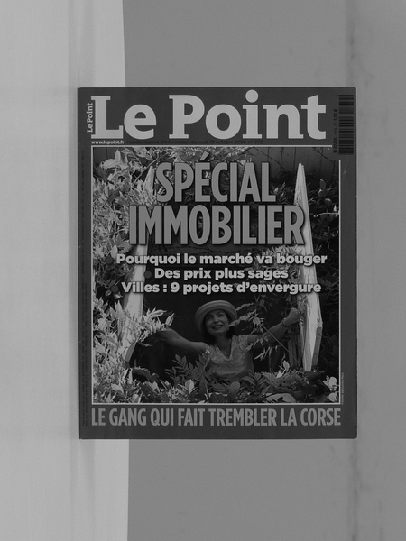
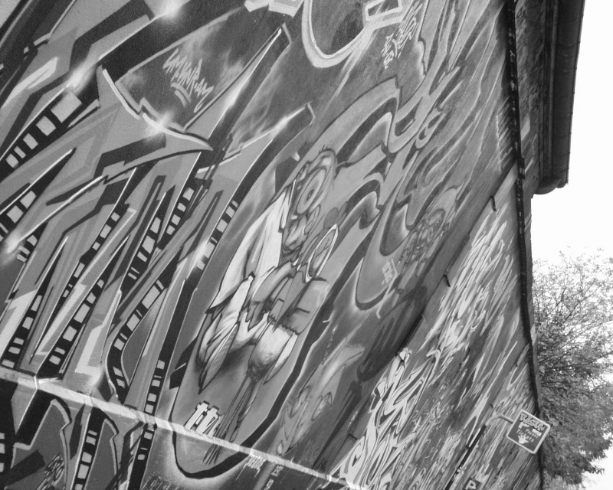
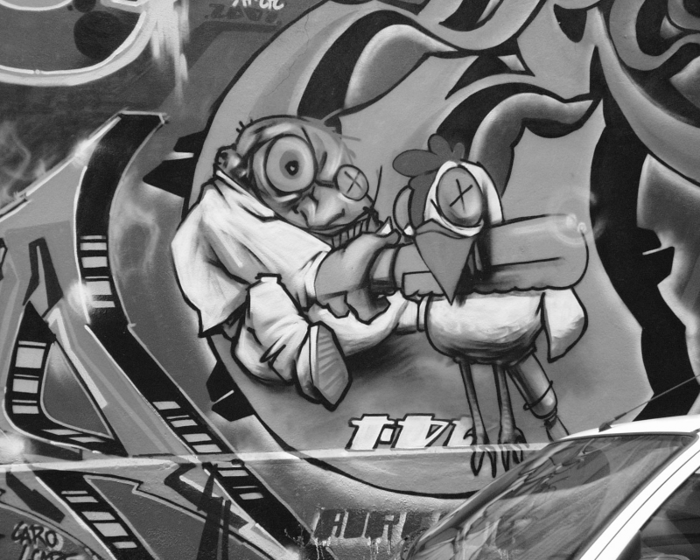
Generalized Template Matching
Find the best …/Translation/Euclidean/Similarity/Affine/Projective/…
transformation between two given images:

Slide 3
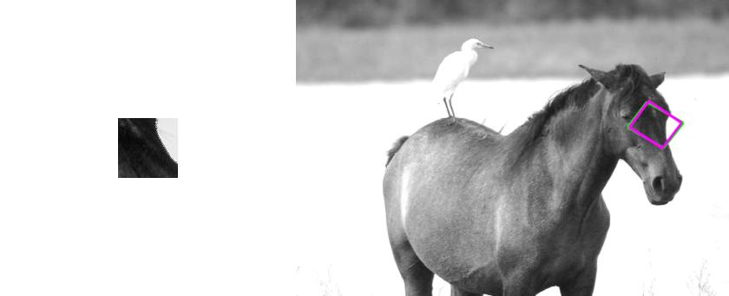
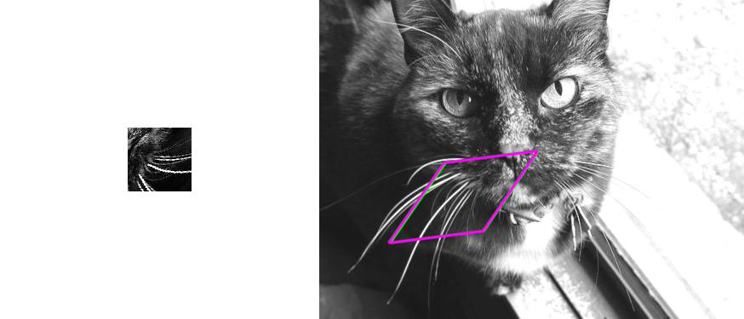
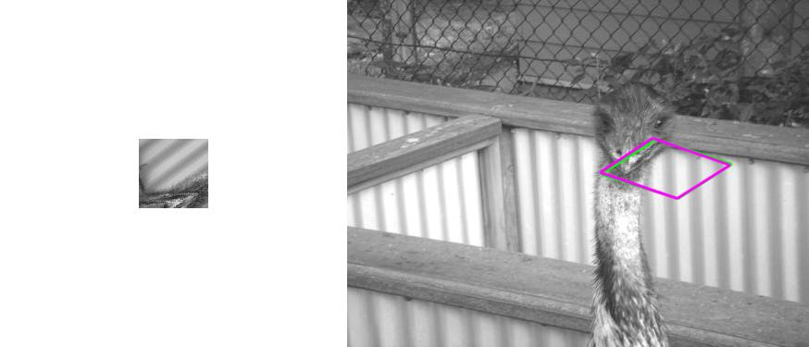
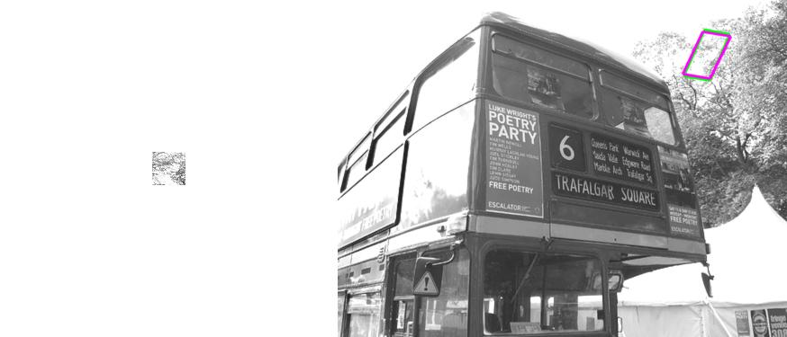
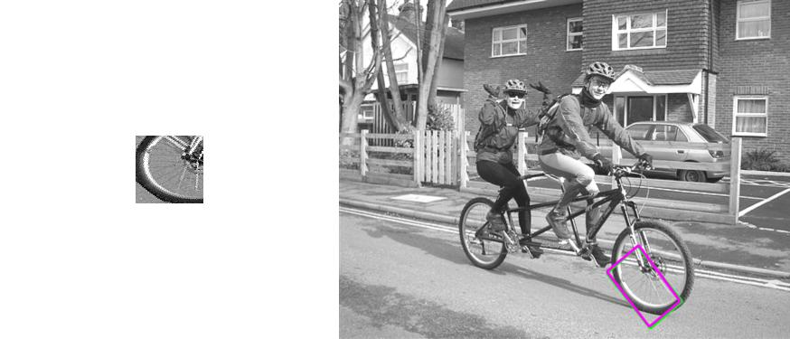
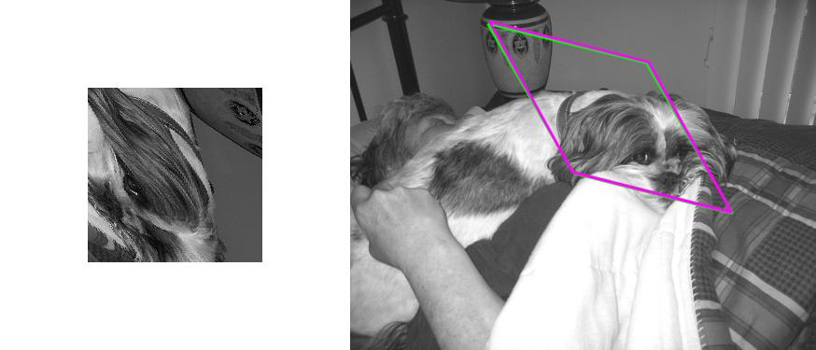
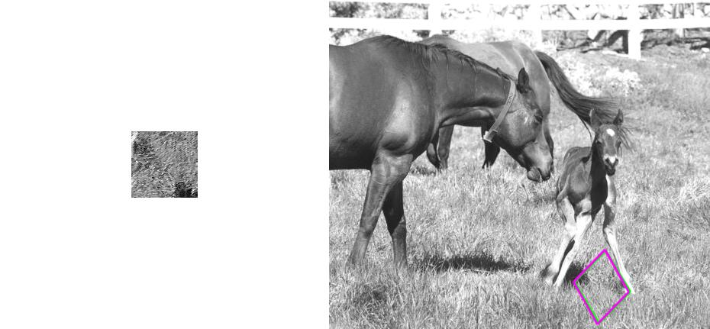
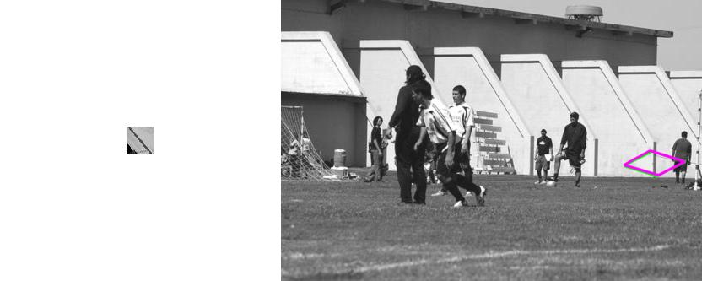
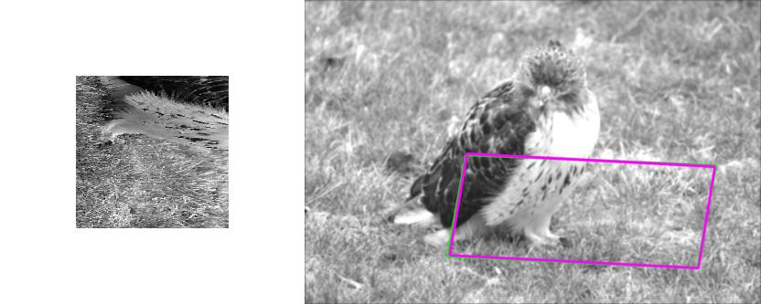
Some results I

Slide 4
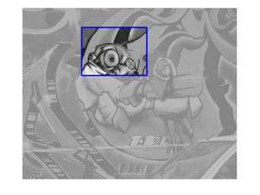
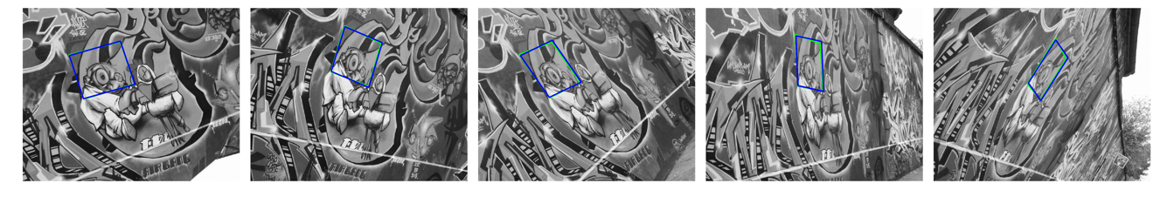
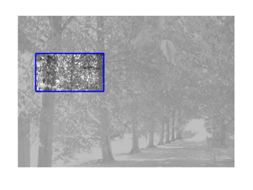
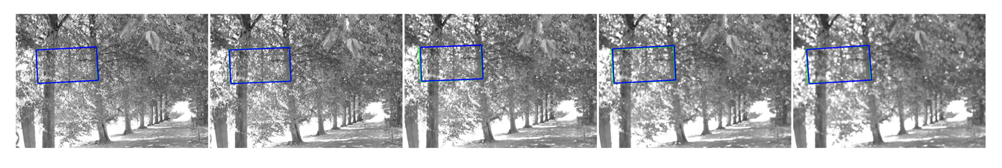
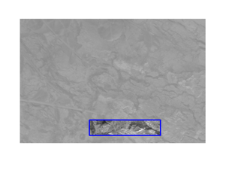
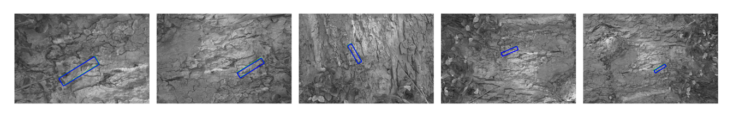
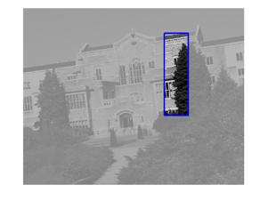
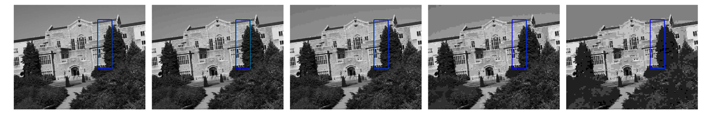
Some results II

Slide 5
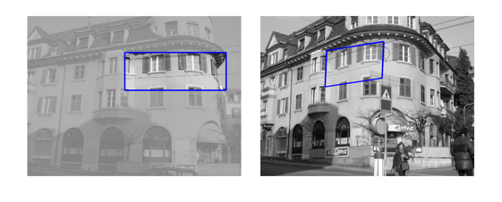
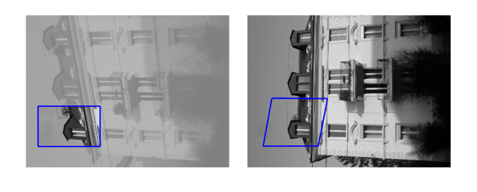
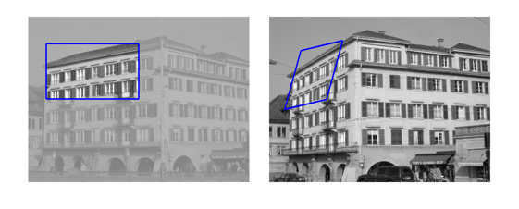
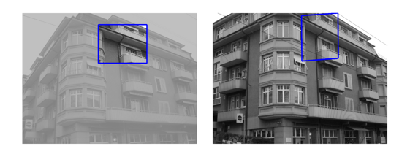
Some results
Some results III

Slide 6
Generalized Template Matching
The algorithm:
1. Take a sample of the Affine transformations
2. Evaluate each transformation in the sample
3. Return the best
Questions:
Which sample to use?
How does is guarantee a bound?

Slide 7
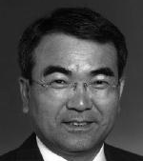
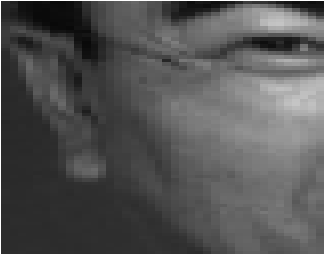
Direct methods – parametric OF
Lucas, Kanade “An iterative image registration technique with an application to stereo vision” [ICAI 1981]
Baker, Matthews “Lucas-Kanade 20 years on: A unifying framework” [IJCV 04]

Slide 8
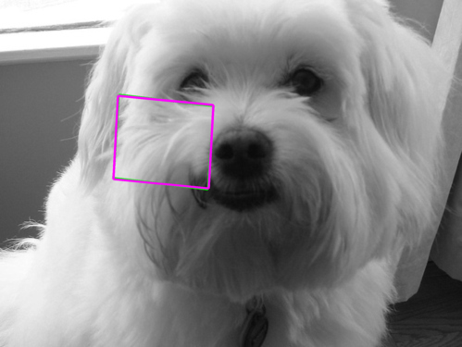

Indirect methods (feature based)
Lowe “Distinctive image features from scale-invariant key-points” [IJCV 04]
Morel, Yu “Asift: A new framework for fully affine invariant image comparison” [SIAM 09]
M.A. Fichler, R.C. Bolles “Random sample consensus” [Comm. of ACM 81]

Slide 9
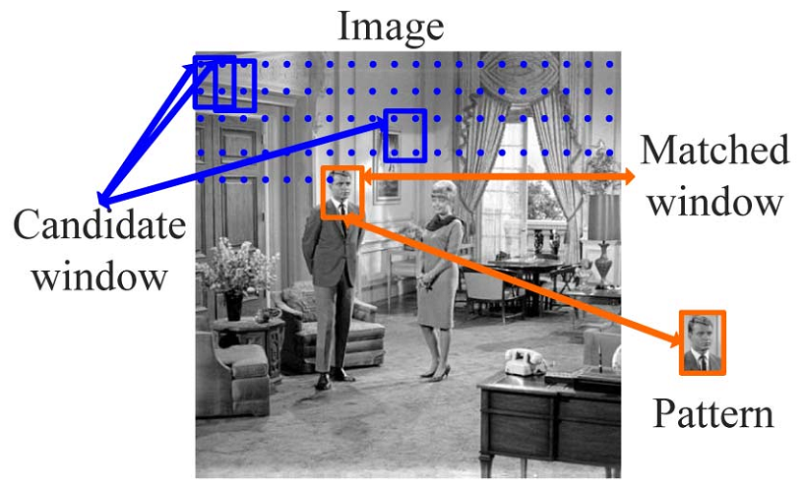
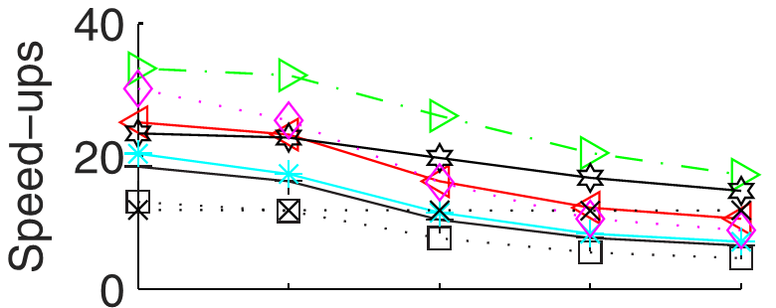
Template Matching - 2D translation (2 dof)
“Performance Evaluation of Full Search Equivalent Pattern Matching Algorithms” [Ouyang, Tombari, Mattoccia, Di Stefano, Cham, TPAMI 2012]

Slide 10
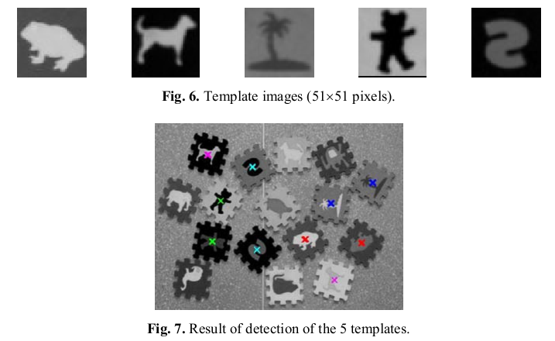
Template Matching – more general (3-4 dof)
+ Rotation (3 dof)
“Rotation Invariant Template Matching” [Fredrikson, 2001]
“Rotation-invariant pattern matching using wavelet decomposition” [Tsai, Chiang 2002]
+ Rotation + uniform scale (4 dof)
“Grayscale template-matching invariant to rotation, scale, translation, brightness and contrast” [Kim, Araujo 2007]
“Retrieval of translated, rotated and scaled color textures” [Yao, Chen 2003]

Slide 11
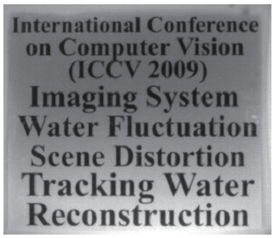
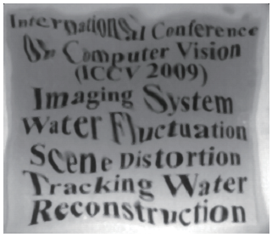
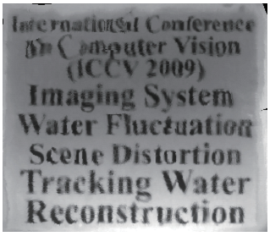
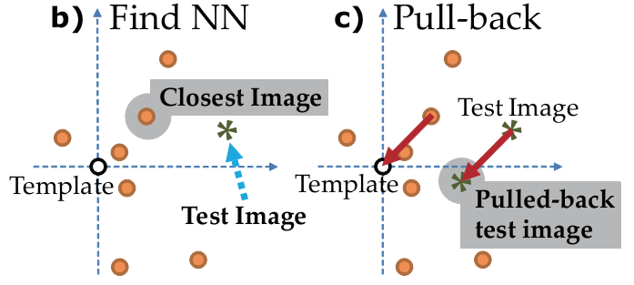
Related work
template
distorted image
rectification
“A Globally Optimal Data-Driven Approach for Image Distortion Estimation” [Tian, Narasimhan, CVPR 2010]

Slide 12
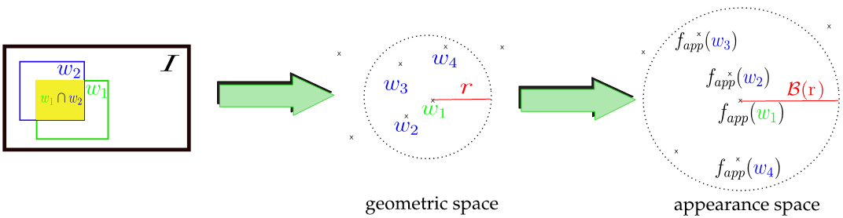
Related work
“Exploiting spatial overlap to efficiently compute appearance distances between image windows” [Alexe, Petrescu, Ferrari, NIPS 2011]

Slide 13
Sublinear Algorithms for Images I
Testing Image Properties [Raskhodnikova, RANDOM, 2003]:
Properties: Connectivity, Convexity, Half-Plane
Global properties can be checked locally

Slide 14
Sublinear Algorithms for Images II
Image Partitioning [Kleiner et. al. PAMI, 2011]:
Test if image can be partitioned into 0/1 squares according to a template
Property may be adapted for different uses
0
1
1
0
1
0
1
0
1

Slide 15
Sublinear Algorithms for Images III
Testing Sparse Images [Ron & Tsur, FOCS, 2010]:
Properties: Convexity, Connectivity etc.
Algorithms and analysis turn out interesting

Slide 16
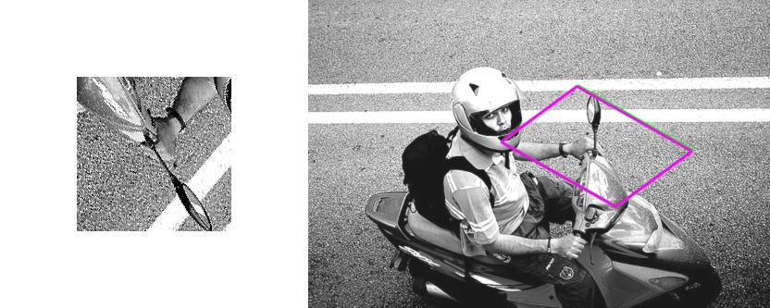
The Main Idea
template
image
Transformation space (e.g. affine)

Slide 17
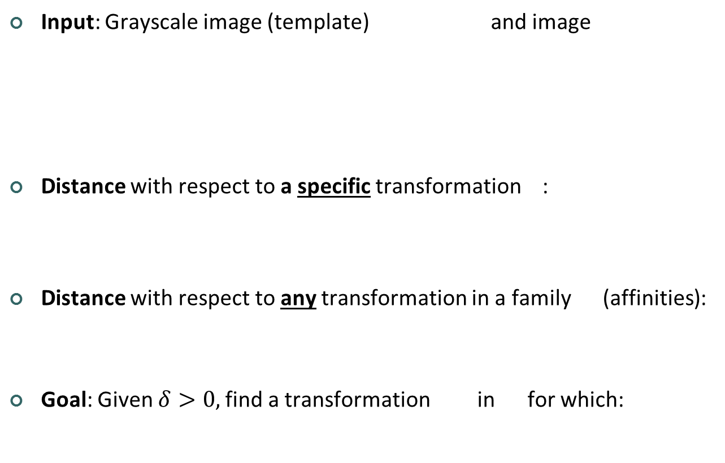
Formal Problem Statement
Input: Grayscale image (template) and image
Distance with respect to a specific transformation :
Distance with respect to any transformation in a family (affinities):
Goal: Given $δ>0,$find a transformation in for which:

Slide 18
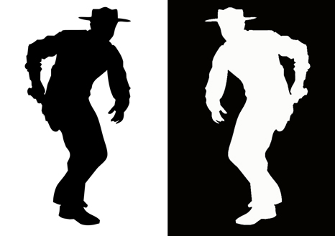
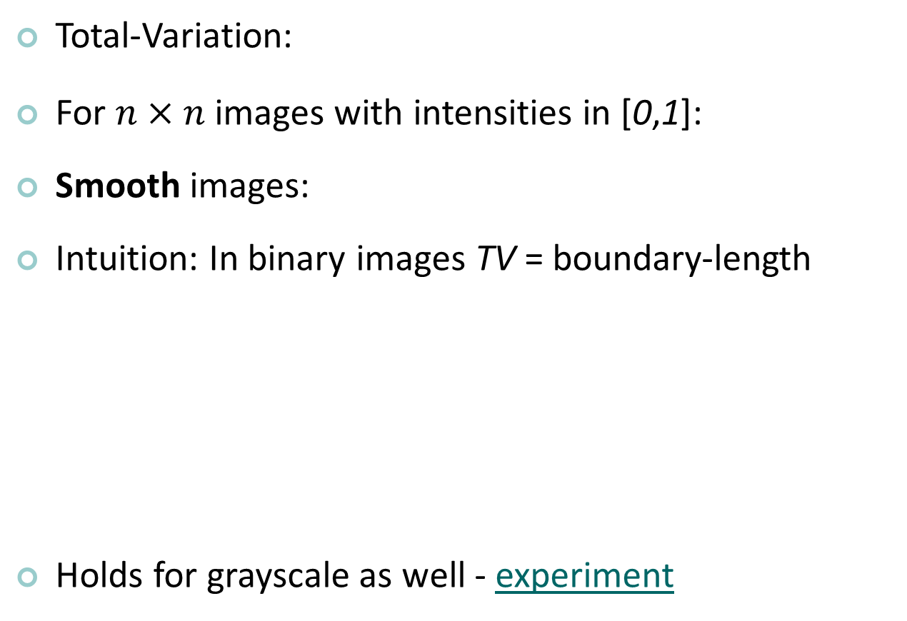
Image Smoothness
Total-Variation:
For $n×n$ images with intensities in [0,1]:
Smooth images:
Intuition: In binary images TV = boundary-length
Holds for grayscale as well - experiment

Slide 19
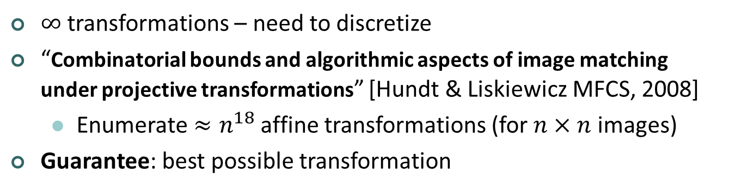
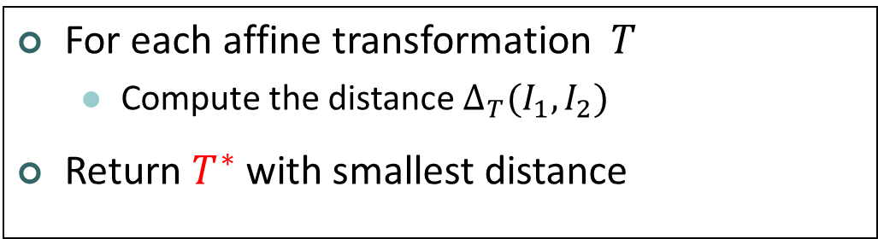
The Algorithm – take 1
For each affine transformation $T$
Compute the distance $∆_{T}(I_{1},I_{2})$
Return $T^{∗}$with smallest distance
$∞$transformations – need to discretize
“Combinatorial bounds and algorithmic aspects of image matching under projective transformations” [Hundt & Liskiewicz MFCS, 2008]
Enumerate $≈n^{18}$affine transformations (for $n×n$ images)
Guarantee: best possible transformation

Slide 20
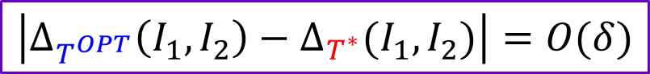

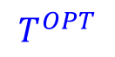
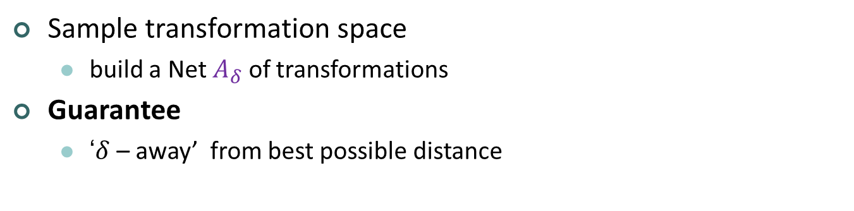
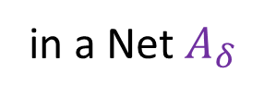
The Algorithm – take 2
in a Net $A_{δ}$
For each affine transformation $T$
Compute the distance $∆_{T}(I_{1},I_{2})$
Return $T^{∗}$with smallest distance
Sample transformation space
build a Net $A_{δ}$ of transformations
Guarantee
‘$δ$ – away’ from best possible distance
$$T^{OPT}$$
$$T^{∗}$$
$$\left|∆_{T^{OPT}}\left(I_{1},I_{2}\right)−∆_{T^{∗}}(I_{1},I_{2})\right|=O(δ)$$

Slide 21
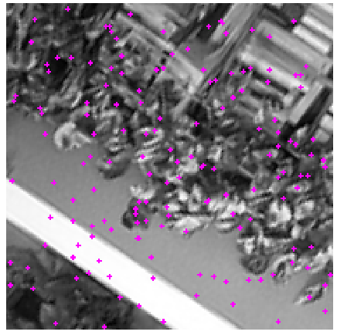
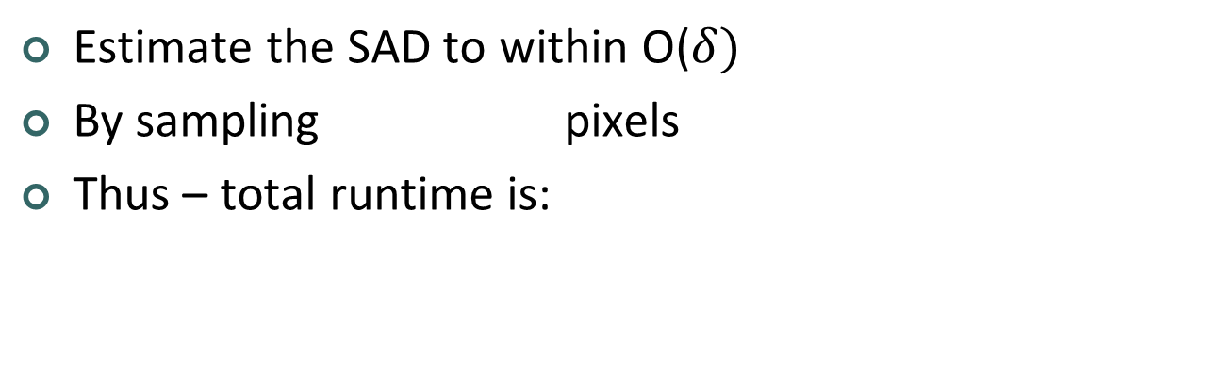
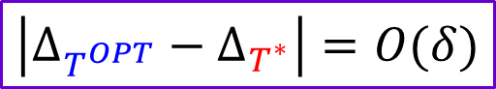
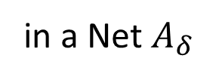
The Algorithm – take 3
in a Net $A_{δ}$
For each affine transformation $T$
Compute the distance $∆_{T}(I_{1},I_{2})$
Return $T^{∗}$with smallest distance
Estimate
estimate
Estimate the SAD to within O($δ)$
By sampling pixels
Thus – total runtime is:
$$\left|∆_{T^{OPT}}\left(I_{1},I_{2}\right)−∆_{T^{∗}}(I_{1},I_{2})\right|=O(δ)$$
$$\left|∆_{T^{OPT}}−∆_{T^{∗}}\right|=O(δ)$$

Slide 22



The net $A_{δ}$
Transformations T₁ and T₂ are x-close
The Net $A_{δ}$
Any affine transformation is δn₁-close to some trans. in $A_{δ}$
($A_{δ}$ is a δn₁-cover of affine transformations)
Possible construction with size:
$${The net A}_{δ}$$
T₁
<x
T₂
x
= δn₁

Slide 23









Approximation – Proof Outline
$${The net A}_{δ}$$
$$T^{OPT}$$
$$T^{Closest}$$
$$T^{∗}$$
Goal:
$$\left|∆_{T^{OPT}}−∆_{T^{∗}}\right|=O(δ)$$
$$\left|∆_{T^{OPT}}−∆_{T^{Closest}}\right|=O(δ)$$
$A_{δ}$ construction
Image smoothness
Main Thm:
Using full transformation evaluation:
$$∆_{T^{∗}}<∆_{T^{Closest}}$$
Using full estimated evaluation:
$∆_{T^{∗}}<∆_{T^{Closest}}$+$O(δ)$

Slide 24






Approximation – Proof Outline
$${The net A}_{δ}$$
$$T^{Closest}$$
$$T^{OPT}$$
δn₁
$$\left|∆_{T^{OPT}}−∆_{T^{Closest}}\right|=O(δ)$$
$A_{δ}$ construction
Image smoothness
Recall that $T^{Closest}$ and $T^{OPT }$are δn₁-close
How worse can $T^{Closest}$ be compared with${ T}^{OPT}$?
Not much – for smooth images

Slide 25






Approximation – Proof Outline
$A_{δ}$ construction
Image smoothness
$$T^{Closest}$$
$$T^{OPT}$$
$$\left|∆_{T^{OPT}}−∆_{T^{Closest}}\right|=O(δ)$$
δn₁
$T^{Closest}$ and $T^{OPT }$are $δn_{1}$-close
Intuition:
Error addition $<\frac{\text{1} }{n^{2}}∙\left(TV∙δn\right)=\frac{TV∙δ}{n}=O(δ)$
(Boundary area )
(smooth: $TV=O(n))$

Slide 26





Fast-Match: a Branch-and-Bound Scheme
Iteratively increase Net-precision (decrease δ)
Throw away irrelevant transformation regions
$T^{Closest}$ is guaranteed to move to next round
(off-net neighbors of above- threshold points are worse than $T^{∗}$)
$${The net A}_{δ}$$
$$T^{Closest}$$
$$T^{∗}$$
$$T^{OPT}$$

Slide 27

Experiment 1: Affine Template Matching
Pascal VOC 2010 data-set
200 random image/templates
Template dimensions of 10%, 30%, 50%, 70%, 90%
‘Comparison’ to a feature-based method - ASIFT
Image degradations (template left in-tact):
Gaussian Blur with STD of {0,1,2,4,7,11} pixels
Gaussian Noise with STD of {0,5,10,18,28,41}
JPEG compression of quality {75,40,20,10,5,2}

Slide 28

Experiment 1: Affine Template Matching
Fast-Match vs. ASIFT – template dimension 50%

Slide 29

Experiment 1: Affine Template Matching
Fast-Match vs. ASIFT – template dimension 20%

Slide 30

Experiment 1: Affine Template Matching
Runtimes

Slide 31

Template Dim: 45%

Slide 32

Template Dim: 35%

Slide 33

Template Dim: 25%

Slide 34

Template Dim: 15%

Slide 35

Template Dim: 10%

Slide 36

Bad overlap due to ambiguity

Slide 37

High SAD due to high TV and ambiguity

Slide 38
Experiment 2: Varying conditions
Mikolajczyk data-set (for features and descriptors)
8 sequences of 6 images, with increasingly harsh conditions
Including:
Zoom+Rotation (bark)
Blur (bikes)
Zoom+rotation (boat)
Viewpoint change (graffiti)
Brightness change (light)
Blur (trees)
Jpeg compression (UBC)
Viewpoint change (wall)

Slide 39


Mikolajczyk– graffiti (viewpoint)

Slide 40


Mikolajczyk– ‘wall’ (viewpoint)

Slide 41
Mikolajczyk– ‘trees’ (blur)

Slide 42


Mikolajczyk – ‘bark’ (zoom+rot)

Slide 43


Mikolajczyk – ‘UBC’ (JPEG)

Slide 44
Experiment 3: Matching in real-world scenes
The Zurich Building Data-set
200 buildings, 5 different views each
200 random instances
Random choice of building, 2 views, template in one view
We seek the best possible affine transformation
In most cases homography or non-rigid is needed
Results:
129 cases - ‘good’ matches
40 cases – template doesn’t appear in second image
12 cases – bad occlusion of template in second image
19 cases – ‘failure’ (none of the above)

Slide 45

Experiment 3: Good cases

Slide 46

Experiment 3: Good cases

Slide 47

Experiment 3: failures, occlusions, out of img.

Slide 48
Fast-Match: Summary
Handles template matching under arbitrary Affine (6 dof) transformations with
Guaranteed error bounds
Fast execution
Main ingredients
Sampling of transformation space (based on variation)
Quick transformation evaluation (‘property testing’)
Branch-and-Bound scheme

Slide 49
Fast-Match: Summary
Limitations
Smoothness assumption
Global transformation
Partial matching
Extensions
Higher dimensions - Matching 3D shapes
Other registration problems
Symmetry detection

Slide 50
Fast-Match
Thanks!
eng.tau.ac.il/~simonk

Slide 51



Image Smoothness
Total-Variation:
For $n×n$ images with intensities in [0,1]:
Smooth images:
9500 random templates
of dim: $n=200±100$
link back

